Slide 1






Theoretical and Computational Foundations for Cyber-Physical Systems Design
Yuankun Xue
University of Southern California
April 11th 2017
Notes:
Good afternoon everyone, my name is Yuankun Xue and I am second year PhD student from University of Southern California and it’s a really pleasant experience to be here on a DATE with great minds here.
Today I am going to present my PhD work towards providing a theoretical and computational basis on which intelligent Cyber-physical System can be constructed. More specifically, in the first part of the presentation, I am
construction of theoretical and computational foundation
-Today I am gonna sharing joint !some of our recent progress on the understanding of physiological processes especially when they have good memories, or in the other words that, the past events of the physiological system, affect where the current state goes into the future.
More specifically, we are trying to learn a data-driven model from the brain-machine-body interface. that is able to describe how the physiological system change over time as a function of multiple signals that have long term memory effect and inter couple over space.

Slide 2
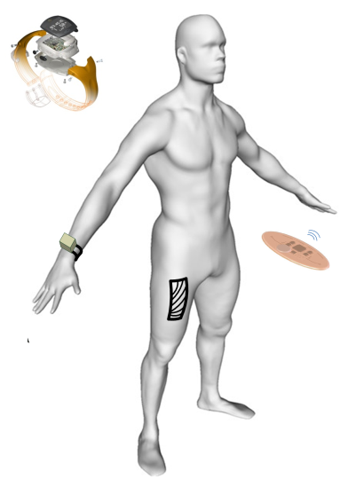
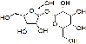

Cyber Physical Systems
Social System
Ecological System
Biological System
Physical
Domain
Sensing
Control
Computation/Communication
Cyber
Domain
Notes:
We are all surrounded by a physical world that is hopeless complicated. Our biological and social existence deeply rooted in seamless interactions with entities from different physical domains. Their understanding, mathematical description, prediction and eventually control pose the major challenges our age. To address this challenges, we connect the physical world with cyber part. We setup sensors to monitor physical process at different scales. and transfer the observation by communication system and translate the information into knowledge base using large scale computation systems. Based on those knowledge,we are able to reconstruct the physical domain to make them behave in our favor. This forms a closed loop cyber physical system.

Slide 3
Major Research Topics of PhD work
I. Modeling framework that enables construction of compact yet accurate models that capture the spatio-temporal dependent structure and long-range memory of the CPS processes
II. A novel design methodology enabling processing and mining the exascale data with best-fit computation and communication architectures via dynamical optimization
Notes:
In the following discussion, I will organize the presentation into three parts. I will present the proposed models and formulate the system identification as an optimization problem and show the algorithm to estimate the parameters. Then the proposed model will be evaluated under two experimental settings and finally I conclude the work.

Slide 4
Major Research Topics of PhD work
I. Modeling framework that enables construction of compact yet accurate models that capture the spatio-temporal dependent structure and long-range memory of the CPS processes
II. A novel design methodology enabling processing and mining the exascale data with best-fit computation and communication architectures via dynamical optimization
Notes:
In the following discussion, I will organize the presentation into three parts. I will present the proposed models and formulate the system identification as an optimization problem and show the algorithm to estimate the parameters. Then the proposed model will be evaluated under two experimental settings and finally I conclude the work.

Slide 5
Motivation: Multi-Physics and Multi-Scales
Vastly varied Physical processes with heterogenous underlying evolving mechanism
Intelligent Transportation
Smart Cities & Disaster Response Systems
Energy and Sustainability
Smart Health Care
Cyber-physical Systems
Notes:
The BMBI has a lot of great promises, to name a few, in health care, we can connect patients with brain disorders or amputees with assistant machines and set up bomb to regain body functionality. or following the similar ideas, we can replace human labors with thought-control robots in settings where human is inefficient, like man fas. or that is dangerous for human beings, like polluted nuclear power plant in fukushima. and also the brain-brain communications as we discussed in previous slides.

Slide 6
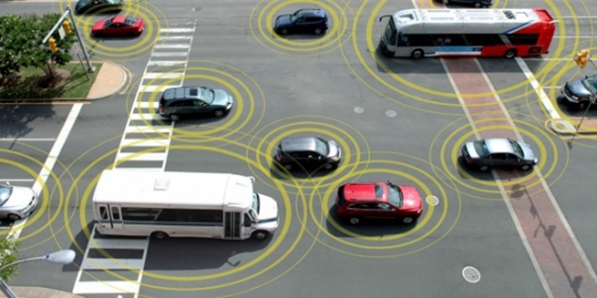
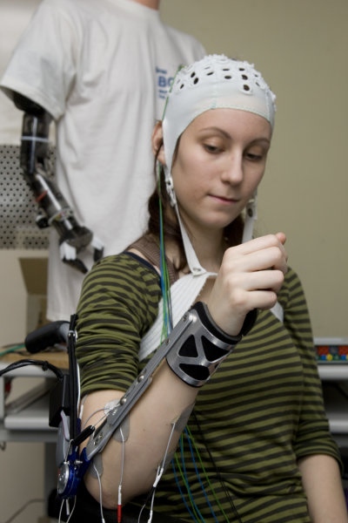
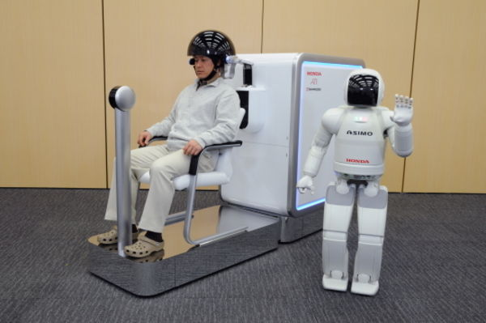
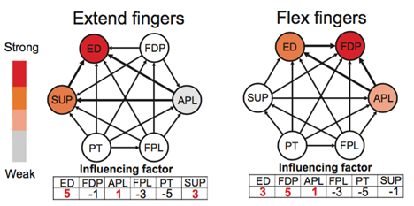
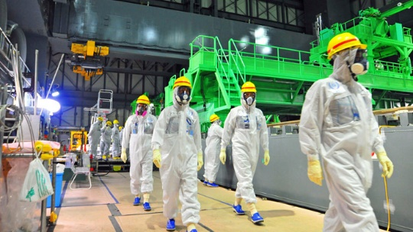
Prescribed Intelligent Capabilities for CPS
What prevents us from
reaching those promises ?
Cognitive learning and autonomy
Mathematical Characterization and Control
Security: Anomaly/Attack detection
6
Spatial and temporal couplings
Notes:
The BMBI has a lot of great promises, to name a few, in health care, we can connect patients with brain disorders or amputees with assistant machines and set up bomb to regain body functionality. or following the similar ideas, we can replace human labors with thought-control robots in settings where human is inefficient, like man fas. or that is dangerous for human beings, like polluted nuclear power plant in fukushima. and also the brain-brain communications as we discussed in previous slides.

Slide 7
Major Model-learning Challenges
Limited knowledge of mathematical structure governing the underlying process evolution
e.g. neural/muscular/vascular system dynamics
Processes exhibit rich inconsistency over instances and non-stationarity over time
A priori postulated models are challenged and difficult to generalize
Strong stochasticity
Well-established modeling techniques strongly rely on non-justified short-term memory assumptions
Integer-order (local) differential equation-based formulation
Markovian switchings
Notes:
First, physiological process is unique in a sense that we have no prior knowledge about the mathematical structure of it and the process dynamics shows inconsistency in different people from time to time. A appropriate model that accurately describe and predict the its behaviors can only be learned from both our observations of the process and its biological nature.
Second, we don like model that is too complicated. even though we have a model that is perfectly in describing the process yet it has large set of parameters and it takes more time than allowed to estimate them. This is especially true for BMBI as
Third, we need efficient algorithm to estimate model. Having a simple model with few parameters doe not necessarily make system identification a tribal task. There is chance that it could be computational intractable. Some nonlinear parameters could simply invalidate the our traditional methods like linear regression.
Therefore, in this work, we are trying to address these challenges in a neuromuscular system by proposing a model learned from the observations and efficient algorithm to estimate the parameters. Of note, we believe the proposed model is general and can be applied to any physical process with strong memories.

Slide 8
Research Tasks
I. How we can advocate for a data-driven modeling framework with minimized postulation allowing for construction of compact yet accurate models that capture spatio-temporal coupling structures of complex dynamics ?
II. What are efficient algorithms for reliable system identification ?
III. How can we leverage the modeling framework to supervise the design of information acquisition process with minimized sensory efforts and guaranteed optimality ?
Notes:
First, physiological process is unique in a sense that we have no prior knowledge about the mathematical structure of it and the process dynamics shows inconsistency in different people from time to time. A appropriate model that accurately describe and predict the its behaviors can only be learned from both our observations of the process and its biological nature.
Second, we don like model that is too complicated. even though we have a model that is perfectly in describing the process yet it has large set of parameters and it takes more time than allowed to estimate them. This is especially true for BMBI as
Third, we need efficient algorithm to estimate model. Having a simple model with few parameters doe not necessarily make system identification a tribal task. There is chance that it could be computational intractable. Some nonlinear parameters could simply invalidate the our traditional methods like linear regression.
Therefore, in this work, we are trying to address these challenges in a neuromuscular system by proposing a model learned from the observations and efficient algorithm to estimate the parameters. Of note, we believe the proposed model is general and can be applied to any physical process with strong memories.

Slide 9
Task I
Compact yet Accurate Modeling Framework for Complex Dynamics
Notes:
First, physiological process is unique in a sense that we have no prior knowledge about the mathematical structure of it and the process dynamics shows inconsistency in different people from time to time. A appropriate model that accurately describe and predict the its behaviors can only be learned from both our observations of the process and its biological nature.
Second, we don like model that is too complicated. even though we have a model that is perfectly in describing the process yet it has large set of parameters and it takes more time than allowed to estimate them. This is especially true for BMBI as
Third, we need efficient algorithm to estimate model. Having a simple model with few parameters doe not necessarily make system identification a tribal task. There is chance that it could be computational intractable. Some nonlinear parameters could simply invalidate the our traditional methods like linear regression.
Therefore, in this work, we are trying to address these challenges in a neuromuscular system by proposing a model learned from the observations and efficient algorithm to estimate the parameters. Of note, we believe the proposed model is general and can be applied to any physical process with strong memories.

Slide 10
Task I: Compact yet Accurate Model for Complex Dynamics
Embrace the complexity of CPS processes
Mathematical characteristics of cyber & physical processes
Long-range memory / correlations, non-Gaussian, fractality
Compact mathematical modeling paradigm
Geometric perspective
Asymmetric dynamics
Capturing spatio-temporal complexity
Maximum causal entropy principle
Notes:
First, physiological process is unique in a sense that we have no prior knowledge about the mathematical structure of it and the process dynamics shows inconsistency in different people from time to time. A appropriate model that accurately describe and predict the its behaviors can only be learned from both our observations of the process and its biological nature.
Second, we don like model that is too complicated. even though we have a model that is perfectly in describing the process yet it has large set of parameters and it takes more time than allowed to estimate them. This is especially true for BMBI as
Third, we need efficient algorithm to estimate model. Having a simple model with few parameters doe not necessarily make system identification a tribal task. There is chance that it could be computational intractable. Some nonlinear parameters could simply invalidate the our traditional methods like linear regression.
Therefore, in this work, we are trying to address these challenges in a neuromuscular system by proposing a model learned from the observations and efficient algorithm to estimate the parameters. Of note, we believe the proposed model is general and can be applied to any physical process with strong memories.

Slide 11
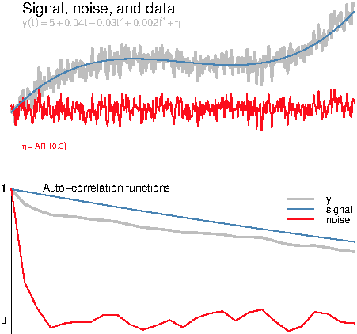
Mathematical Memory
Short-range memory
Autocorrelation function decays exponentially with the lag k
Autoregressive (integrated) moving average AR(I)MA models
order (p,q) for i = 0 (of order (p,i,q) for integer i > 0)
where
Long-range dependence (memory)
Autocorrelation function decays as a power law with the lag k
Fractional autoregressive integrated moving average (FARIMA) models
order (p,d,q) with d the fractional (non-integer) order differencing operator
Paul Doukhan, George Oppenheim, Murad Taqqu, Theory and Applications of Long-Range Dependence, Springer 2002
Notes:
As a case investigation, we measure the muscular signals involved majorly when we abduct our thumbs and report the observations at extensor and abductor muscles. in the figures of first column. you can notice this process is non-smooth with a lot of peaks and valleys.
To study temporal dependencies, or how the past process states affect the current state. we measure the sample autocorrelation functions in the figures of second column. The x axis shows the index of lagged samples. the y shows how strong it is correlated with current states.
We notice in these two figures that the correlation strength decays not exponentially as a function of the lag index,which is a very common assumption, but following a power-law. Or intuitively, it decays slower than we expect as lag index goes back time. This observation is best illustrated when we put the correlation strength and lag index in a log-log plot. This is shown in the first figure of column 3. You can notice that the correlation changes following a linear function in the log-log plot.
This suggests that, the strength of temporal dependency decays a function of index t to the power alpha, alpha is the slope of the linear function in this figure.
This is could be translated as the current states correlates longer back in time. Or in more informal way, the process has longer memory than we assumed.
We also measured how strong the signals at different muscle sites correlate with each other. The figure in the bottom of the third column shows the sample cross correlation functions of two muscles and their correlation with white noise. Compared to that of white noise, the sample cross correlation function between two muscles , shows not only each signal gets affected by its own previous states, but also received influence from other signals.
Overall, we can make two important observations here,
1. xxxxxx
2. xxxxxx
These observations make us believe the euro-muscular process is fractal in nature.Before I get into details, I believe to many of the audience, a little bit explanation on what is fatality could be be very useful

Slide 12
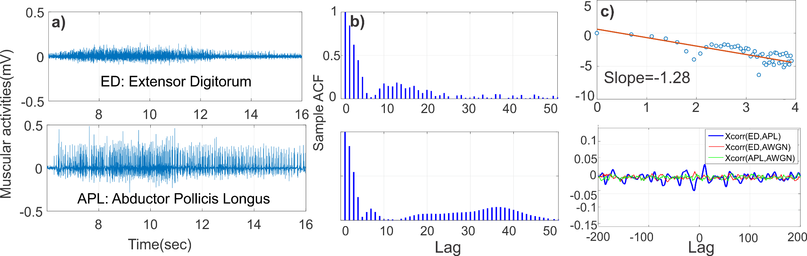
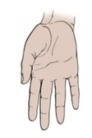

Real processes exhibit long-range memory
iEMG
Measurment
Autocorrelation
Decreases
following a power-law
Spatio-temporal coupling
Remarks:
Neuro-muscular process exhibits long-range memory governed by a power law
Neuro-muscular process is a multivariate process with spatio-temporal dynamic intercoupling
Thumb abduction
Notes:
As a case investigation, we measure the muscular signals involved majorly when we abduct our thumbs and report the observations at extensor and abductor muscles. in the figures of first column. you can notice this process is non-smooth with a lot of peaks and valleys.
To study temporal dependencies, or how the past process states affect the current state. we measure the sample autocorrelation functions in the figures of second column. The x axis shows the index of lagged samples. the y shows how strong it is correlated with current states.
We notice in these two figures that the correlation strength decays not exponentially as a function of the lag index,which is a very common assumption, but following a power-law. Or intuitively, it decays slower than we expect as lag index goes back time. This observation is best illustrated when we put the correlation strength and lag index in a log-log plot. This is shown in the first figure of column 3. You can notice that the correlation changes following a linear function in the log-log plot.
This suggests that, the strength of temporal dependency decays a function of index t to the power alpha, alpha is the slope of the linear function in this figure.
This is could be translated as the current states correlates longer back in time. Or in more informal way, the process has longer memory than we assumed.
We also measured how strong the signals at different muscle sites correlate with each other. The figure in the bottom of the third column shows the sample cross correlation functions of two muscles and their correlation with white noise. Compared to that of white noise, the sample cross correlation function between two muscles , shows not only each signal gets affected by its own previous states, but also received influence from other signals.
Overall, we can make two important observations here,
1. xxxxxx
2. xxxxxx
These observations make us believe the euro-muscular process is fractal in nature.Before I get into details, I believe to many of the audience, a little bit explanation on what is fatality could be be very useful

Slide 13
Real processes exhibit long-range memory
iEMG
Measurment
Autocorrelation
Decreases
following a power-law
Spatio-temporal coupling
Neuro-muscular process is
Fractal in nature !
Thumb abduction
Notes:
As a case investigation, we measure the muscular signals involved majorly when we abduct our thumbs and report the observations at extensor and abductor muscles. in the figures of first column. you can notice this process is non-smooth with a lot of peaks and valleys.
To study temporal dependencies, or how the past process states affect the current state. we measure the sample autocorrelation functions in the figures of second column. The x axis shows the index of lagged samples. the y shows how strong it is correlated with current states.
We notice in these two figures that the correlation strength decays not exponentially as a function of the lag index,which is a very common assumption, but following a power-law. Or intuitively, it decays slower than we expect as lag index goes back time. This observation is best illustrated when we put the correlation strength and lag index in a log-log plot. This is shown in the first figure of column 3. You can notice that the correlation changes following a linear function in the log-log plot.
This suggests that, the strength of temporal dependency decays a function of index t to the power alpha, alpha is the slope of the linear function in this figure.
This is could be translated as the current states correlates longer back in time. Or in more informal way, the process has longer memory than we assumed.
We also measured how strong the signals at different muscle sites correlate with each other. The figure in the bottom of the third column shows the sample cross correlation functions of two muscles and their correlation with white noise. Compared to that of white noise, the sample cross correlation function between two muscles , shows not only each signal gets affected by its own previous states, but also received influence from other signals.
Overall, we can make two important observations here,
1. xxxxxx
2. xxxxxx
These observations make us believe the euro-muscular process is fractal in nature.Before I get into details, I believe to many of the audience, a little bit explanation on what is fatality could be be very useful

Slide 14


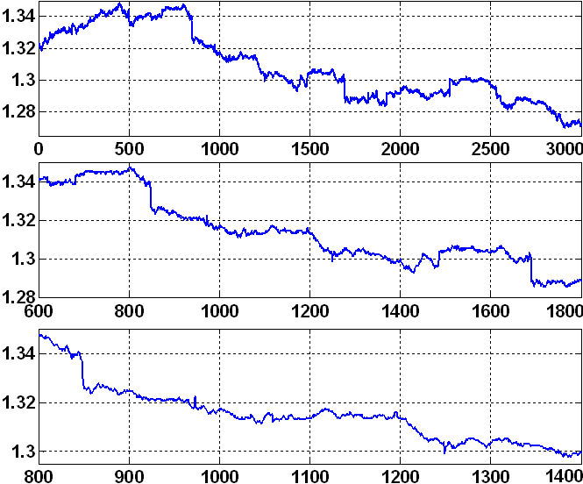



What is Fractal ?
Non-fractal
Smooth geometric object displaying no similarity under magnification operation
Fractal
Geometric fractal is an object exhibiting a jagged shape in space or spiky behaviors in time and some degree of repetition or self-similarity over a wide range of scales
Swiss francs to US dollars exchange rates
Notes:
1. Geometrically, we consider a object that is non fractal if it is smooth and does not repeat itself if you look it at different scales. For instance for this full sphere, they are different if you look at them at different scales.
2. In contrast, a fractal object or a fractal process is usually non-smooth in space and time. It always show jagged shape in space like the patterns of mountains, or spiky behaviors if it is a process. it will demonstrate some degree of self-similarity or repetition.
But how this is related to a physical process ?

Slide 15
Real process is Fractal in nature: Non-smoothness
Real world processes (and their trajectories) are not always smooth: continuous but nowhere (integer-) differentiable
Fractional behavior
g(x)
x
g(x)
x
15
Notes:
First of all, we notice almost all real process are not smooth and rich in peaks and valleys where you can not define an integer derivative to characterize its changing over time.

Slide 16
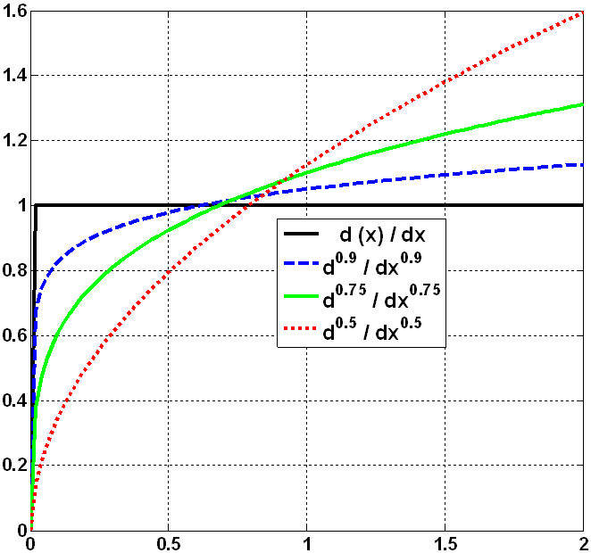
Real process is Fractal in nature: Memory
Impact of power law memory kernel
Fractional dynamics goes beyond integer calculus (which is local or memory-less)
Represents the convolution between a memory kernel and the function of interest
f(x) = d^{α}( x )/dx^{α}
16
x
Riemann-Liouville fractional derivative
Continuous form:
Power-law kernel
Function of interest
Notes:
And as we notice the neuron-muscular process demonstrate long memory effect, the system state dynamics is affected by its previous states back in a long time. Such dynamics is difficult to be characterized by integer derivatives because it is in nature local in time.
An integer derivative only depends on the where you define. for instance in this figure, if take the first order derivative for a linear function, we will obtain a constant. its value only depends the changing rate of the function over a infinitely narrow interval. or Informally we can say integer derivative is memory less and local.
However, in contrast, fractional order derivative represents a convolution between a power-law memory kernel and the function of interest. As we see in fractal derivative formula, the fractional order derivative of the function of interest f(t), is a convolution between a memory kennel following a power law governed by alpha and you have to consider the integral back in time. Or in a discrete form, integral is replaced by summation.
This is suggests, its value does not only depends on where you define it, but also on the previous value. Hence, it is embedded with memories.
Such properties coincide with what we have observed in neuromuscular process, therefore we propose to model it using the fractal dynamics.

Slide 17
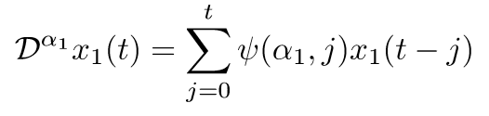
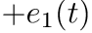
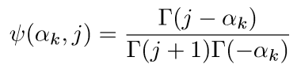
Real process is Fractal in nature: Memory
Impact of power law memory kernel
Fractional dynamics goes beyond integer calculus (which is local or memory-less)
Represents the convolution between a memory kernel and the function of interest
f(x) = d^{α}( x )/dx^{α}
17
x
Grunwald-Letnikov operator
Or in discrete form:
Power-law kernel
Function of interest
Notes:
And as we notice the neuron-muscular process demonstrate long memory effect, the system state dynamics is affected by its previous states back in a long time. Such dynamics is difficult to be characterized by integer derivatives because it is in nature local in time.
An integer derivative only depends on the where you define. for instance in this figure, if take the first order derivative for a linear function, we will obtain a constant. its value only depends the changing rate of the function over a infinitely narrow interval. or Informally we can say integer derivative is memory less and local.
However, in contrast, fractional order derivative represents a convolution between a power-law memory kernel and the function of interest. As we see in fractal derivative formula, the fractional order derivative of the function of interest f(t), is a convolution between a memory kennel following a power law governed by alpha and you have to consider the integral back in time. Or in a discrete form, integral is replaced by summation.
This is suggests, its value does not only depends on where you define it, but also on the previous value. Hence, it is embedded with memories.
Such properties coincide with what we have observed in neuromuscular process, therefore we propose to model it using the fractal dynamics.

Slide 18
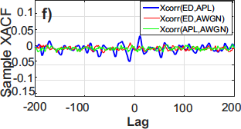
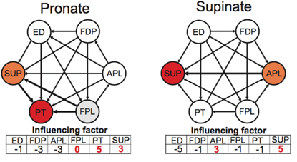
Real processes exhibit spatial cross-coupling
Cross long-range dependence (LRD)
Quantified via the sample cross-correlation function (SXACF)
SXACF analysis among iEMG signals shows higher values than between the iEMG singal and an additive white Gaussian noise (AWGN)
Interdependent networks are time varying
Notes:
As a case investigation, we measure the muscular signals involved majorly when we abduct our thumbs and report the observations at extensor and abductor muscles. in the figures of first column. you can notice this process is non-smooth with a lot of peaks and valleys.
To study temporal dependencies, or how the past process states affect the current state. we measure the sample autocorrelation functions in the figures of second column. The x axis shows the index of lagged samples. the y shows how strong it is correlated with current states.
We notice in these two figures that the correlation strength decays not exponentially as a function of the lag index,which is a very common assumption, but following a power-law. Or intuitively, it decays slower than we expect as lag index goes back time. This observation is best illustrated when we put the correlation strength and lag index in a log-log plot. This is shown in the first figure of column 3. You can notice that the correlation changes following a linear function in the log-log plot.
This suggests that, the strength of temporal dependency decays a function of index t to the power alpha, alpha is the slope of the linear function in this figure.
This is could be translated as the current states correlates longer back in time. Or in more informal way, the process has longer memory than we assumed.
We also measured how strong the signals at different muscle sites correlate with each other. The figure in the bottom of the third column shows the sample cross correlation functions of two muscles and their correlation with white noise. Compared to that of white noise, the sample cross correlation function between two muscles , shows not only each signal gets affected by its own previous states, but also received influence from other signals.
Overall, we can make two important observations here,
1. xxxxxx
2. xxxxxx
These observations make us believe the euro-muscular process is fractal in nature.Before I get into details, I believe to many of the audience, a little bit explanation on what is fatality could be be very useful

Slide 19
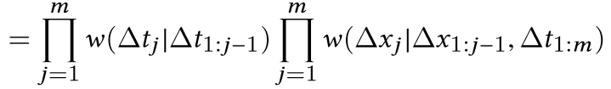
Capture Spatio-Temporal Coupling: A Microscopic View
x(t)
Magnitude of negative increments in the stochastic process x(t)
Magnitude of positive increments in the stochastic process x(t)
t
Inter-event time t₂-t₁ = Δt
Inter-event time distribution
dictates memory of the process
Spatial increments distribution
dictates the degree of non-linearity
Notes:
Analysis of the magnitude of positive and negative increments in the stochastic process
dictates the degree of nonlinearity / confidence in linearity assumption
Analysis of inter-event times distribution
dictates whether the stochastic process has short-range or long-range memory

Slide 20
Capture Spatio-Temporal Coupling: A Microscopic View
x(t)
Magnitude of negative increments in the stochastic process x(t)
Magnitude of positive increments in the stochastic process x(t)
t
Inter-event time t₂-t₁ = Δt
Inter-event time distribution
dictates memory of the process
Spatial increments distribution
dictates the degree of non-linearity
How can we construct dynamical state equation ?
Notes:
Analysis of the magnitude of positive and negative increments in the stochastic process
dictates the degree of nonlinearity / confidence in linearity assumption
Analysis of inter-event times distribution
dictates whether the stochastic process has short-range or long-range memory

Slide 21
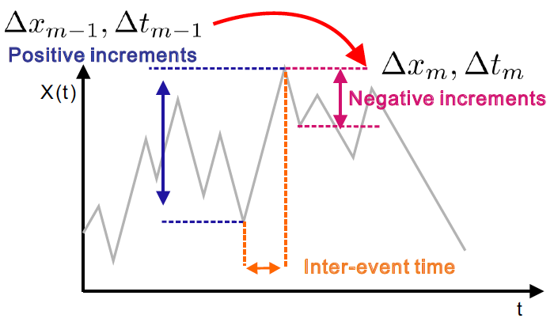
Maximum Causal Entropy Principle
How to estimate w(Δx, Δt)?
subject to
Power law family of solutions
Essential is a relative gain / regret time-directional entropy
Yuankun Xue and Paul Bogdan, Constructing Compact Causal Mathematical Models for Complex Dynamics, to appear in April 2017

Slide 22
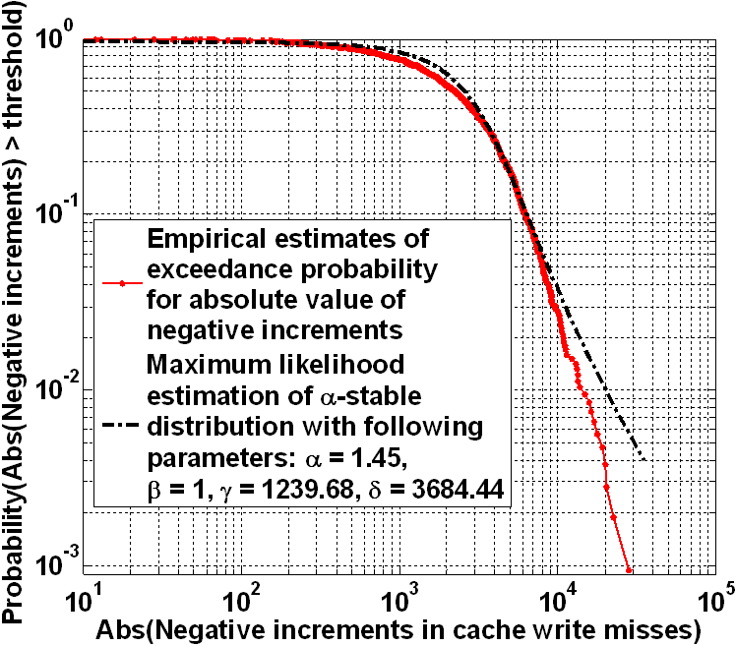
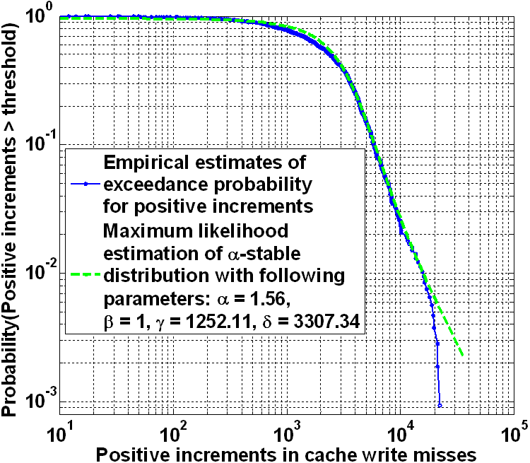
Data-Driven Modeling – Learning From Data
Probabilistic description using generalized Master Equation
Quantify probability P(x,t|α,β) of process x(t) to attain value x at time t whose magnitude increments and inter-event times are characterized by fractal dimensions α and β
Initial condition
Coupling between negative increments and their inter-event times
Coupling between positive increments and their inter-event times

Slide 23
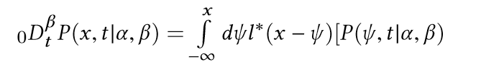
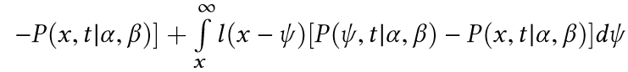
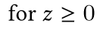
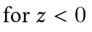
Establish Dynamical State Equation
Generalized fraction-order master equation
Consider the asymmetry of + and – increments and power-law solutions family to the maximum causal entropy problem:
Assume transition functional can take following general form:
Transition functional for + magnitude increments
Transition functional for - magnitude increments

Slide 24
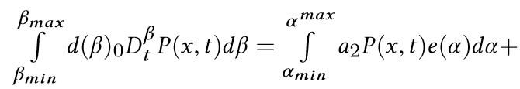
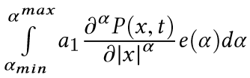
Establish Dynamical State Equation (Cont’d)
Connects to Riesz-Feller fraction-order derivative:
Consider the general case where the transition probability is described by the distribution of power-law exponents , we have
Temporal dependency
Space dependency

Slide 25
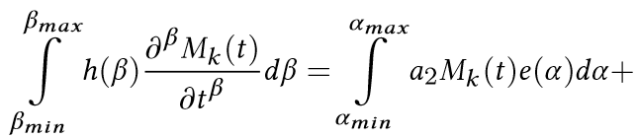
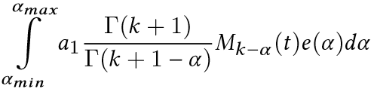
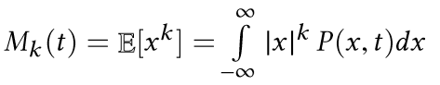
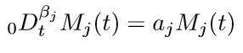
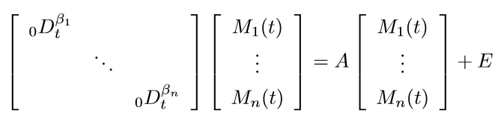
Establish Dynamical State Equation (Cont’d)
Multiply both sides with |x|^{k}, integrate over x-magnitude space by noting k-th order moment, we have:
Consider the first-order moment and discretize via Grunwald-Letnikov fractional-derivative operator, we retrieve:
.
Note: M_{j}(t) is the mean of j-th process
Incorporate noise term and spatial cross coupling for multi-dimensional case:
.
Spatial-Temporal Fractal Dynamical Model

Slide 26
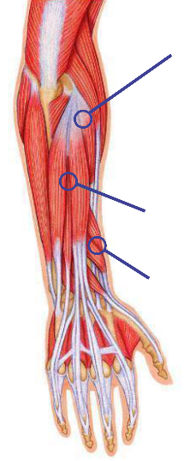
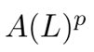
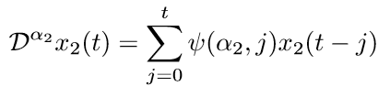
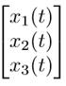
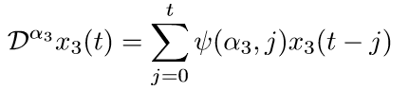
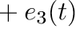
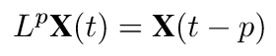
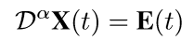
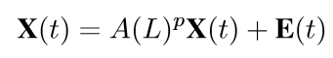
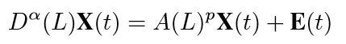
Spatio-Temporal Fractal Model Explanation
Temporal dependencies
Spatial dependencies
Spatio-temporal Fractal (STF) system model dynamics
Notes:
We consider neuromuscular process involving multiple participants, channels. the system state transition of each of them is characterized by a fractal derivation governed by a fractional order exponent alpha.
different channels may have different alphas. Due to property of fractal derivatives, the system state transition is influenced by all its past values, hence this is embedded long term temporal dependencies in this model.
Combined with process noise, which is the turbulence of the system, we now have the system free response in matrix form considering the long term temporal dependencies.
Meanwhile, we should also consider the inter coupling between different channels back in time. We use A(L) to the power p to denote a series of coupling matrix that pass down the influence from other channels back in p time steps to the current system states. L is backshift operator.
Thus we represent another part of system dynamics that consider the spatio dependencies.
Combine this two parts, we have the spatio-temporal fractal model.

Slide 27
Task II
Spatio-Temporal Fractal Model Algorithmic Retrieval
Notes:
First, physiological process is unique in a sense that we have no prior knowledge about the mathematical structure of it and the process dynamics shows inconsistency in different people from time to time. A appropriate model that accurately describe and predict the its behaviors can only be learned from both our observations of the process and its biological nature.
Second, we don like model that is too complicated. even though we have a model that is perfectly in describing the process yet it has large set of parameters and it takes more time than allowed to estimate them. This is especially true for BMBI as
Third, we need efficient algorithm to estimate model. Having a simple model with few parameters doe not necessarily make system identification a tribal task. There is chance that it could be computational intractable. Some nonlinear parameters could simply invalidate the our traditional methods like linear regression.
Therefore, in this work, we are trying to address these challenges in a neuromuscular system by proposing a model learned from the observations and efficient algorithm to estimate the parameters. Of note, we believe the proposed model is general and can be applied to any physical process with strong memories.

Slide 28
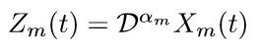
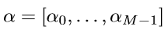
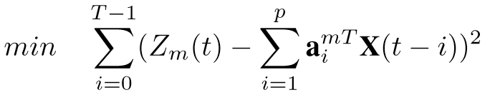
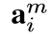
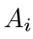
Problem statement
Spatio-temporal Fractal System Identification Problem
Given a finite observation interval [t, t+T] over the M-dimensional STF system.
Define,
Determine fractional order exponents
and coupling matrix
as m-th row vector of coupling matrix in
Notes:
Slide 25
Therefore, our objective is to identify this spatipo-temperoal fractal system given finite observations. Or in a formal way, we can formulate the system identification as an optimization problem. Given finite observations on the physical process over an interval T,
Let us define the Zm(t) as the model output given observations considering only the fractal temporal dependencies. alpha i, m denotes the m-th row vector in coupling matrix A_i which passes down the influence from other channels that is i steps earlier. we want to determine the fractal order exponents alpha, and all the coupling matrix A up to p steps easier, such that the accumulated difference between the observations and predicted output is minimized.

Slide 29
Not another linear regression problem
Remarks:
Linear regression is infeasible unless we have priori knowledge about the fractional order exponents
Notes:
To solve this problem, we should notice the following observations. first, this is not another simple linear regression problem unless we have priori knowledge about the fractal order exponent alpha. if alpha is known to us, then we only have to estimate the coupling matrix given observations, this is a classic linear regression problem. However, we usually have no idea about alpha. therefore, linear regression is infeasible.

Slide 30
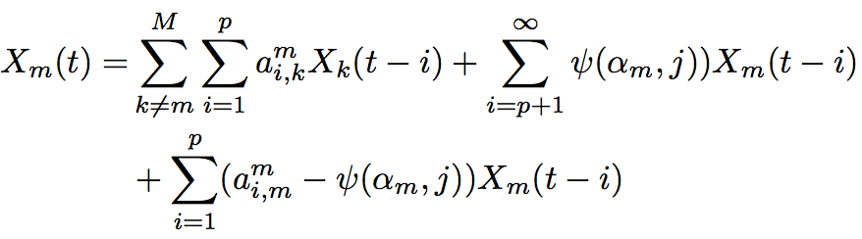
Our solution
Consider the m-th subproblem:
m-th row vector of coupling matrix
Rewrite it,
Notes:
Therefore, our solution start with estimating fractional order alpha. By rewriting the objective function, we can notice the current system state is decide by three terms. The first term is the spatial dependencies from other channels. The second and third terms are the temporal dependencies. The second term encodes the long term memory effect that is governed by the fractal exponents and the third term is the short term temporal dependencies which is similar in ARMA model.
We notice the coefficient in the long term dependencies from the memory kernel of fractal derivative. it can be well approximated by a power law governed by the alpha.
This serves as the core of our estimation algorithm. we first estimate the A(L) matrix assuming p is large. then we will put the estimated coefficients in A(L) with the lag index i, and fit a linear function in a log-log plot. The slope is our fractal order exponents.
Then with knowledge of alpha, we can go ahead with any possible approaches, quadratic optimization, linear regress, to solve the problem.

Slide 31
Our solution
Consider the m-th subproblem:
m-th row vector of coupling matrix
Rewrite it,
Spatial dependencies
Notes:
Based on subdividing…...
Zm is
a_i^{m}

Slide 32
Our solution
Consider the m-th subproblem:
m-th row vector of coupling matrix
Rewrite it,
Long term temporal dependencies
short term temporal dependencies
Notes:
Based on subdividing…...
Zm is
a_i^{m}

Slide 33
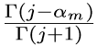
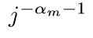



Our solution
Notice and can be well
approximated by given large .
Such that we have,
Remarks:
Putting the relation between j and memory kernel coefficients leads
to a linear function with its slope=

Slide 34
Experimental Setup 1
STF model is considered
2,4,8 time series simulated to produce 1000 trajectories for each
Length=1024,2048,4096
Estimation errors measured in terms of normalized root mean square errors(NRMSE)
Notes:
To evaluate effectiveness of the algorithm and model, we set up two experimental settings. In the first setting, we use the model to produce trajectories given a fixed set of fractal orders and coupling matrix. then we use the proposed algorithm to estimate. the estimation errors are reported in terms of normalized root mean square errors.
We show the estimation error in the figures. x shows the length of time series we use to estimate the parameters, y is the error. one can notice that
Given enough xxxxxxx
As we reduce the length of observations, there will be a phase transition point and this marks the lower bound of observation length required to …..

Slide 35

How long do we need to identify the parameters ?
Phase transition
Phase transition
Phase transition
Notes:
We show the estimation error in the figures. x shows the length of time series we use to estimate the parameters, y is the error. one can notice that
Given enough xxxxxxx
As we reduce the length of observations, there will be a phase transition point and this marks the lower bound of observation length required to …..

Slide 36

Estimation errors given limited observability
8 time series simulated to produce 1000 trajectories for each
We have the access to 2, 4, 8 channels of the process
Length=1024
Notes:
Here we show how the loss of information affects the estimation accuracy. We consider a 8-channel process produced by the model, assuming we observe only 2 or 4 channels of it. The results show another phase transition phoneasada, as we limit our observations $from 8 to 4, the estimation errors does not change so much. However, xxxxxxx, this shows the loss of information might irreversibly damage the estimator accuracy.

Slide 37

Experimental Setup 2
3 healthy subjects
4 forearm movements
6 muscles considered
iEMG signals are collected by ADI EMG system
Notes:
In the following experiments,
we consider the clinical measurements from 3 healthy subjects when they are asked to perform different set of movements. 6 muscle channels are considered.

Slide 38



How well STF model fits to the data ?
Estimation error(NRMSE) summary

Slide 39
Recall: How many sensors are required ?
8 time series simulated to produce 1000 trajectories for each
We have the access to 2, 4, 8 channels of the process
Length=1024
Notes:
Here we show how the loss of information affects the estimation accuracy. We consider a 8-channel process produced by the model, assuming we observe only 2 or 4 channels of it. The results show another phase transition phoneasada, as we limit our observations $from 8 to 4, the estimation errors does not change so much. However, xxxxxxx, this shows the loss of information might irreversibly damage the estimator accuracy.

Slide 40
Task III
Minimum Number of Sensors to Ensure Observability
Notes:
First, physiological process is unique in a sense that we have no prior knowledge about the mathematical structure of it and the process dynamics shows inconsistency in different people from time to time. A appropriate model that accurately describe and predict the its behaviors can only be learned from both our observations of the process and its biological nature.
Second, we don like model that is too complicated. even though we have a model that is perfectly in describing the process yet it has large set of parameters and it takes more time than allowed to estimate them. This is especially true for BMBI as
Third, we need efficient algorithm to estimate model. Having a simple model with few parameters doe not necessarily make system identification a tribal task. There is chance that it could be computational intractable. Some nonlinear parameters could simply invalidate the our traditional methods like linear regression.
Therefore, in this work, we are trying to address these challenges in a neuromuscular system by proposing a model learned from the observations and efficient algorithm to estimate the parameters. Of note, we believe the proposed model is general and can be applied to any physical process with strong memories.

Slide 41

EEG Dynamics

Slide 42

Minimal sensor placement (Allerton 2016)

Slide 43

Minimal sensor placement

Slide 44

Minimal sensor placement

Slide 45

Minimal sensor placement- EEG

Slide 46

Minimal sensor placement- EMG

Slide 47

Minimal sensor placement- ECG

Slide 48
Major Research Topics of PhD work
I. Modeling framework that enables construction of compact yet accurate models that capture the spatio-temporal dependent structure and long-range memory of the CPS processes
II. A novel design methodology enabling processing and mining the exascale data with best-fit computation and communication architectures via dynamical optimization
Notes:
In the following discussion, I will organize the presentation into three parts. I will present the proposed models and formulate the system identification as an optimization problem and show the algorithm to estimate the parameters. Then the proposed model will be evaluated under two experimental settings and finally I conclude the work.

Slide 49




Handling with extremely large data
Exorbitantly large data generation
Physiological sensing
Large scale deployment
Intrinsic complexity
Smart grid/Smart cities…
Genomics sensing
Beyond computing power we have easy access to !
Notes:
The BMBI has a lot of great promises, to name a few, in health care, we can connect patients with brain disorders or amputees with assistant machines and set up bomb to regain body functionality. or following the similar ideas, we can replace human labors with thought-control robots in settings where human is inefficient, like man fas. or that is dangerous for human beings, like polluted nuclear power plant in fukushima. and also the brain-brain communications as we discussed in previous slides.

Slide 50


Example: Precise/Personalized medicine
Storage : ~40EB
Processing: ~10,000 Trillion CPU hours
100 to 1,000 times greater than the computing power we have by then
EB=10¹⁸ Bytes= 1 Billion GB
1PB=0.001 EB
Notes:
Variant calling on 2 billion genomes per year, with 100,000 CPUs in parallel, would require methods that process 2 genomes per CPU-hour, three-to-four orders of magnitude faster than current capabilities

Slide 51

Demanding needs: Not a projection into 2025
Example in Precise medicine: illumina High Seq X sequencer system
Most advanced short-read sequencer to date
Raw sequenced data with coverage 30X
Raw whole genome data
Throughput 24/7
Processing requirement
>150 GB
>18,000
<29 min
per person
Per year
per sample
Notes:
Among which, brain machine body interface triggers very special interest as it is closely related to our daily life and has immediate benefit to improve our life quality at an individual basis.
Brain machine body interface is a translator in general.
By deciphering the brain activities at the brain machine body interface, we can translate them into control signals that drive equipments to act in a desirable and intuitive way. We can also modulate the neural activities with the messages and communicate them with different people with a demodulators. And also, it could be used for thought-control machinery.

Slide 52
Demanding needs: Not a projection into 2025
Example in Precise medicine: illumina High Seq X sequencer system
Most advanced short-read sequencer to date
Raw sequenced data with coverage 30X
Raw whole genome data
Throughput 24/7
Processing requirement
>150 GB
>18,000
<29 min
per person
Per year
per sample
Comparison: >32 Hours(from raw data to VCF file) using BWA-GATK
Platform: 12-core Xeon E5-2697 v2 with 128GB memory
Notes:
Among which, brain machine body interface triggers very special interest as it is closely related to our daily life and has immediate benefit to improve our life quality at an individual basis.
Brain machine body interface is a translator in general.
By deciphering the brain activities at the brain machine body interface, we can translate them into control signals that drive equipments to act in a desirable and intuitive way. We can also modulate the neural activities with the messages and communicate them with different people with a demodulators. And also, it could be used for thought-control machinery.

Slide 53




The failure of well-established computing paradigm
End-users
Not the best-fit computing architecture
The architecture is not optimized with awareness of the application
Data movement is expensive
LAN Access networks
Traffic transforms the computation-intensive tasks into communication intensive tasks
Extremely high bandwidth requirement on end-users
150GB in 30min=700Mbps
Interconnection:
-Congestion
-Dropped packets
-Timeouts
-Failures
Data-centers
Most speedy way to deliver ?
Storage I/O Access
Storage:
-Lack of Bandwidth
-Overloaded
PCIe connect
-Storage device contention
Distributed storage

Slide 54
Motivation: Bottom-up design flow
Bottom-up based design and evaluation flow
Unguided reconfiguration scheme proposal
No performance guarantee->non-converged design iteration
Benchmark set/Application of interest
Apps
Met -> Success(?)
NoC
Proposal
Evaluation
Objective ?
Failed
Metrics
Notes:
Despite their decent success in specfic problem settings, a fundamental limitation of these prior works lies on the their bottomp-up problem space exploration flow.
In such flow, A noc is proposed ->then evaluated ->subset->under ->then we will compare with our design objective to validate the proposal or invalidate it. There are two fundamental disadvantage in this flow
-first the design objective/specifciation does not play a actively role in guiding the design of the NoC, we make no predcition on the expected performance of the proposed NoC reconfiguration scheme.
-second: we have no in two -> first, a ref noc is proposed without predicatable performance leading to a non-converged design iteration.
Second, we have no guarantee the proposed will generalize to other application not considered in the experiemntal setting.
Therefore,

Slide 55
Motivation: Problem space not well explored
Benchmark set/Application of interest
Apps
Met -> Success(?)
NoC
Proposal
Evaluation
Objective ?
Failed
Metrics
Extremely difficult to explore the design space
Constrained applicability and hard to generalize
Notes:
Therefore,
Non converged design cycel
A bottom-up design and validation flow make the exploration of problem space extremely difficult as a result of non-converged iteration cycle.
False converged
Even though the design is converged and validated under predefined metrics(network latency, throughput, power consumption, fault resilience), using a set of applications of interest or benchmark suites, it does not necessarily mean proposed NoC reconfiguration technique generalize well to other applications as well.
In simple words, a bottom-up design flow gives answers to the question that if the proposed reconfigurable noc is better than a baseline design given a specific application set.
However, a more fundamental question we should ask is the opposite: what is the approperiate reconfigurable noc to be considered if we have a set of applications and constraints. This calls for a shift from a bottom-up to a top-down design flow.

Slide 56
Application-aware design flow (top-down)
Application of interest
Benchmark synthesis
Profiling
Apps
Apps
Design
Synthesis
Processing
Evaluation
NoC
Objective
Metrics
Task I: A proper modeling of the application and optimization framework for Communication Arch synthesis
Task II: A benchmarking framework that efficiently synthesizes an array of test cases to:
Evaluate NoC performance with the actual workload pressure
Consider variations in different application settings

Slide 57


T1:Synthesize NoC with optimality bound
Presented at NOCS2016

Slide 58
Major research questions for Task I
What is the appropriate model we should consider on which we base our solution search in a formal setting?
What is the optimization problem and what is the structure of the solution space ?
What algorithm we should use for solution with guaranteed optimality
Notes:
First, What is the appropriate model that enables our search in the solution space as general as possible such that the model can be applied to investigate the NoC reconfiguration problem in a widely ranged scenarios.
In other words, we woud like to formualte the reconfiguration problem based on a model of good applicability such that the chance to find the best-fit solution is maximized as a result of a well expanded solution space.
Second, a vastly expanded solution space might not necessrily be a perfect news for us as it translates to increased computational complexity such that optimization might not be practically solvable especially when we consider a runtime reconfigurable NoC. Therefore, we need to understand what is the optimization problem and is there any structure in the solution space that can be used for design of an efficient algorithm rather than a brute-force search?
Thirdly, the top-down flow requires the performance of the NoC obtained from the optimization is predictable. In other words, an algorithm that solves the optimization should deliver solutions with bounded optimality.

Slide 59

Reconfigurable NoC model setup
At time t :
A reconfigurable NoC is a connected dynamic directed graph
Augmented connectivity
Set (ACS)
Physical link
Function unit
Routing function
Express lane for data exchange
A circuit link between a node pair is a direct link that allows circuit switching
A circuit component is a subset of N(t) if a circuit link path exists between any two nodes
Notes:
Intuitively, a reconfigurable NoC is different form the regular NoC in the sense that the network composition, data delivery from a given source to a destination and network topology are not fixed but changing over the time course at runtime.
To formally capture such dynamic behaviors, we borrow the idea from graph thoery and represent a reconfigurable NoC as a dyanmic graph.
Where, at the time t, a tile of function units is modeled as a node in the graph and N(t) denotes the set of enabled functional units.
E(t) is a collection of active physical links and gamma(t) is a routing function determines the data delivery path between any pair of nodes.
Ideally , if there is a dedicated physical link that allows circuit switching between any pair of nodes, we will end up with a fully connected inerconnection with optimal performance.
In practice, a circuit link is set up in reconfigurable NoC system in addtiion to the regular links to improve the network performance over critical traffic path. By connecting different circuit links together, it is possible for a subset of nodes to communicate over dedicated circuit links for faster data exchange, which, later we will show, serves as a keystone in our formulation of NoC reconfiguration problem.
For convenience of discussion, we introduce the definition for a circuilt component in which there exists a data delivery path consisting of circuit links between any pari of nodes in this subset.

Slide 60

Define reconfigurability of NoC
ACS is a subset of nodes to which n_{i} can set up alternative physical links
Connectivity constraint
A node is a reconfigurable if its ACS is non-empty.
A NoC system is reconfigurable if there exists at least one node that is reconfigurable.
Reconfiguration=>E(t) evolves over time by picking up nodes in ACS to change the data delivery path
Notes:
It should be noted that the first three tuples defines a regular NoC without reconfiguration features. To be able to model and express the reconfiguration capability, we define the augmented connectivity set C:
An augmented connectivity set C of a node ni is defined to describe the capaibility to set up alternative physical links to other nodes in the current network. Such link could be regular or circuit link.
For any node in the network, We define the node as a reconfigurable node as long as its aACS is non-empty. This can be understood as the capability of this network to change the way of data delivery between a pair of nodes. If we have multiple such reconfiugrable nodes, their combinations could sustains a huge solution space with considerable number of new possible data delivery paths.
Therefore, formally we define the a network is reconfigurable as long as one of its candidate node has non-empty augmented connectivity set.
Even though this reconfigurable concept is rather abstract. We still need to consider the actual physical or topological imitations from the low-level implementation.
-For instance, an alterantive link issued by a given node might constrain its reach to make sure data could be delivered in a single cycle. Therefore, only a subset of nodes can be possible reached given a specific hardware implementation.
-Or the number of alternative links shall be less than a threshold due to hardware limitation or some links can not be established at the same time due to connectivity constraints.
To consider these in our model, we introduce the connectivity constraints for every node. Both alpha and X are binary numbers, alpha is used to mask or unmask a node into the constrain, Xj equal to 1 meaning nj could be potentially linked.
K is a integer that limits the number of alternative links to be set up at the same time.
By considering an array of such constraints for each node, we are able to capture physical and topological limitation into the model to be realistic with no loss of generaliy.
By introducing the ACS into the model, the reconfiguration of NoC can be understood as a process where we pick up nodes from ACS and constructing new edges over time such that E(t) evolves as a function of reconfiguration decisions made prior to time t.
However, a subsequent question is how we can make such reconfiguration decisions ? We actively change the network configurations because the traffic workloads of the network changes over time as a consequence of arrival of new applications or spatio-temporal variability of the running application over its executiom horizon.
Therefore, the fundamental driver of the reconfiguration decision is the application workloads. To continue our discussion for formulation of the NoC reconfiguration problem, an appropriate model for application shall be included. Even though our model is general and has no constraints on profiling technique, we choose a graphical model to be consistent with our NoC model.

Slide 61

Application graphical model
An application is profiled as a dynamic directed graph
Data/Sync dependency
Task
Profiling system
is finite functionality alphabet given specific application
is the profiling function that map a task to its functionality requirements
Example in a numeric computation task
={0,1,2,3}
Integer addition
& multiplication
0-> float point
2-> addition
1-> integer
3->multiplication
Notes:
An application we consider here is profiling via a dynamic graphical model where node represents its task and edge encodes the data or synchronization dependencies between task pairs.
To make connection between NoC model and application model, we introduce profiling system to capture functionality requirement of each task.
A profiling system consists two component,. Sigma is a finite functionality alphabet given speficif appliction contect. A symbol in this alphabet is a basic functionality to our interest considering. For instance, sigma can be as simple as a integer number set with 4 elements in a numeric task. 0 to 3 denotes four basic functionality. A profiled task that has 1, 2, 3 requires integer addition and multiplication operaitons.

Slide 62
Application graphical model
An application is profiled as a dynamic directed graph
Data/Sync dependency
Task
Profiling system
is finite functionality alphabet given specific application
is the profiling function that map a task to its functionality requirements
Example in a numeric computation task
={0,1,2,3}
Same function can be defined to profile the capability of a functional unit in G(t) !
0-> float point
2-> addition
1-> integer
3->multiplication
Notes:
As we said before, this profiling system serves as a connection between the noc model and the applicatio model in the sense that the same profiling system can be used to profile the capability of a functional unit in the network.
Intuitively, a noc system is capable to carry an application only if the functionality requirement of the application tasks is a subset of the capability of the NOC.
Also, we are not satisfied if an application can run on the current NoC system. This is not our objective of reconfiguration. The reconfiguraion is a peformance-driven decision making process. We need to keep asking if the current network configuration is the best choice or not ?
Ideally, we will run the application on a subset of nodes if they are joined by links that are superior in bandwidth, latency and power consumption and they are capable to run it. In other words, the reconfiguration decision is made by searching for such a subset of nodes in the netowrk such that we could run this application safe and fast.
To formally discuss this problem, we need to put the two model together and discuss how they are related.

Slide 63



Model interplays: Compatible partition
An application partition $π$is compatible if for every $π_{k}∈π$, there exists a circuit component T_{k} that satisfies
A l-relaxed circuit component is a subset of nodes in N(t) that allows at most l non-circuit-switching paths .
An application partition $π$is l-compatible if for every $π_{k}∈π$, there exists a l-relaxed circuit component T_{k} that satisfies above constraints
Notes:
The interplay between two models originante from the requirement to search for the best fit network configuration for the applications. This searching process actually try to partition the application and induce an optimal mapping to the noc domain such that inter-task communication happens over as many dedicated links as possible.
Formally, we define such a partition as a compatible partition as long as
For every subset of task in the partition, we can always find a circuit component that is able to accommodate these tasks.
The first constraints make sure the task can be accomodated. The second forbid the cases where we have more tasks than computing resources available. The third constraints is saying that a circuit component can not be shared.
This compatible partition is actually a quite strong definition. In reality, we might not have so many circuit component that satisfies this definition. Therefore, we introduce some relaxation.
A l-relaxed circuit compoent is a subset of nodes that allows at most l-non-circuit switching paths. This put relaxation on the definition of circuit component. We do not require a data delivery path consisting of all circuit links between any pair of nodes in the set, altrnatively, we allows a portion of them made up of regular links.
This definition leads to a relaxation on the definition of compatible as well as the we are not asking all the partitios have their corresponding circuit component to accommodate them. We will accept some inperrfect circuit components.
Later we will see, this actually leaves space for our algorithm design in a practical setting.
Given such partition can be found, we need to quantify the performance gain over over a baseline design such that we can analytically use our design objective to guide our network reconfiguration process. Therefore, we introduce the following quantities

Slide 64

Quantify performance gain
Intra-component bandwidth (gain) factor
Inter-component bandwidth (gain) factor
Intra-component traffic takes the circuit links of high bandwidth
Inter-component traffic takes advantage of multiple paths set up simultaneously between components
Notes:
Intra-component bandwidth gain factor can be easily understood from our previous discussion as circuit link set up between node pairs provides dedicated and augmented bandwidth with no competition. Inter-task traffic in the application travels over such links enjoys a performance gain which is quantified by f alpha ti.
In contrast, traffic travels between circuit component has no advantages to enjoy dedicated bandwidth gain but given that fact the data can be fast exchanged within a circuit component, it is possible a data stream can be sent simultanesouly over multiple path lying between the source circuit component and the destination component and forwarded to the real destinatin node via dedicated links after arrival. This also translates to augmented bandwidth which is quantifyed by F r ti tj.

Slide 65


Problem statement
NoC Reconfiguration Problem
Given an NoC system described by
an application profiled by
at time t and execution horizon T
Find a partition $π$ of and corresponding circuit components that maximize :
Subject to: partition$π$ is compatible.
Notes:
Given an NoC reconfigurable system described by the proposed model and the application of interest profiled in a graphical model with a profiling system P that links the NoC model and application model.
We would like to search for a partition pi and its corresponding circuit component such that a performance gain function is maximized
Subject to pi is compatible.
The objective function here considers a summation of performance gain over all circuit components constructued. The summation consists of two terms, the first one is actually a expected value of performance gain. Q sigma is the overall traffic volume and q(ti) is the volume of traffic travels within the circuit components that enjoyts intra-cmoponent performance gain f alpha. This ratio represents the contribution of performance gain of circuit component T_{i}. By sum up it over all circuit components, the first term corresponds to the average performance gain.
The second term considers the power savings as circuit links consumes less power by skipping the routing stages and congestions. E delta is power saved over the baseline design assuming all links in T_{i} are regular links. Lamda is a regularization parameter that place different weights on power saving and performance gains.
Overall,as we discussed, this NoC reconfiguration problem is a searching process for the best fit noc given a specifc application. However solving this optimization problem is not a trivia task, unfortunately, this problem is NP-Hard

Slide 66
A bounded greedy algorithm
Given a partition
Search for a circuit component that maximize the local gain of objective function
Until the partition is l-compatible

Slide 67

A simple architectural example
A simple switch-box based reconfigurable NoC
Statically assigned time slot for each node in the circuit component
Self-negotiated link access control (SNAC)

Slide 68
Experimental results: NoC configurations
Constructed circuit components
Notes:
As a case investigation, we measure the muscular signals involved majorly when we abduct our thumbs and report the observations at extensor and abductor muscles. in the figures of first column. you can notice this process is non-smooth with a lot of peaks and valleys.
To study temporal dependencies, or how the past process states affect the current state. we measure the sample autocorrelation functions in the figures of second column. The x axis shows the index of lagged samples. the y shows how strong it is correlated with current states.
We notice in these two figures that the correlation strength decays not exponentially as a function of the lag index,which is a very common assumption, but following a power-law. Or intuitively, it decays slower than we expect as lag index goes back time. This observation is best illustrated when we put the correlation strength and lag index in a log-log plot. This is shown in the first figure of column 3. You can notice that the correlation changes following a linear function in the log-log plot.
This suggests that, the strength of temporal dependency decays a function of index t to the power alpha, alpha is the slope of the linear function in this figure.
This is could be translated as the current states correlates longer back in time. Or in more informal way, the process has longer memory than we assumed.
We also measured how strong the signals at different muscle sites correlate with each other. The figure in the bottom of the third column shows the sample cross correlation functions of two muscles and their correlation with white noise. Compared to that of white noise, the sample cross correlation function between two muscles , shows not only each signal gets affected by its own previous states, but also received influence from other signals.
Overall, we can make two important observations here,
1. xxxxxx
2. xxxxxx
These observations make us believe the euro-muscular process is fractal in nature.Before I get into details, I believe to many of the audience, a little bit explanation on what is fatality could be be very useful

Slide 69
Experimental results: Performance metrics
Reduced network latency and increased capability for heavy traffic
Reduced latency
~52.3%
Increased capability for heavy traffic

Slide 70
Review: Application-aware design flow (top-down)
Application of interest
Benchmark synthesis
Profiling
Apps
Apps
Design
Synthesis
Processing
Evaluation
NoC
Objective
Metrics
T1: A proper modeling of the application and optimization framework for Communication Arch synthesis
T2: A benchmarking framework that efficiently synthesizes an array of test cases to:
Evaluate NoC performance with the actual workload pressure
Consider variations in different application settings

Slide 71
Task 2: Problem statement
Benchmarking System Construction Problem
Given an application of interest
Find a benchmarking system that is able to learn the application structure and capture its properties via mathematical model for synthesis of benchmarks
Subject to:
High fidelity
Architectural independence
Scalable
Efficient

Slide 72


Benchmarking system construction
Presented at CODES+ISSS 2016

Slide 73
Overview of NoC benchmarking framework
3-stage benchmarking framework
Application profiling
Mathematical modeling
Scalable benchmark synthesis

Slide 74


1st layer: Instrumentation and runtime collection
The first layer has two major components:
Modified LLVM-compiler scanner
Runtime library
ISA
C/C++
Clang Frontend
Instrumented IR
Event List
LLVM Intermediate
Representation(IR)
Instrumented
Assembly
Contech scanner
Target architecture

Slide 75

1st layer: An instrumentation example
Recording data access patterns
Address, Size, Read/Write
Local thread buffer
In-lined assembly

Slide 76
1st layer: Synchronization task
Local synchronization is identified by:
LLVM instructions
Name of the function called
Synchronization action is recorded by:
Action address
Order of the action in relation to other sync actions on the same address
Time stamps
Global list of buffers is maintained :
Partial dependency is preserved in each local thread buffer
Content of local buffer will be queued into the global list to enforce ordering

Slide 77


2nd layer: task graph construction
Scan through the event list:
Accumulate basic blocks until a synchronization task is encountered

Slide 78




3rd layer: Mathematical modeling
Understand application from a mathematical perspective
Execution delay
Communication delay

Slide 79









Model of computation for application
Definition 1 (Application task):
An application task is a quadruple
is a timed finite state machine
is a data generation process
is set of tasks on which prior dependency exists
Definition 2 (Timed finite state machine):
A timed finite state machine is a 6-tuple
and is the input and output channel set
is the transition function
is the output function
Definition 3 (Application):
An application B(t) is a dynamical graph defined over T where:
A node is a task
Edges represent their interdependency
Notes:
Manipulate
Another beauty

Slide 80


Quantify application similarity
State vector at t:
An execution of model B(t):
A recorded execution trace:
Similarity between real application behavior and output of the simulated model B(t) is given by :
Remarks:
NoC benchmark synthesis problem is equal to minimize this error

Slide 81



Evaluation: Injection strength

Slide 82
Summary
Developed a compact yet accurate modeling framework that captures the spatio-temporal coupling and long-range CPS process memory.
Developed an efficient system identification algorithm determined the minimal requirements for observability. Propose a sensor selection algorithm with guaranteed optimality for CPS design
Proposed a general mathematical framework with guaranteed optimality for search of best-fit communication architecture based on reconfigurable NoC
Propose a scalable benchmarking framework that efficiently synthesizes test cases to evaluate NoC performance with high fidelity

Slide 83
Planned work
Determine the minimal requirement of sensors to ensure observability considering unknown inputs into the STF model
Explore the applicability of the proposed STF model in the extended set of physiological processes for evaluation of its characterizing and predictive power.
Extend the multifractal analysis to connectivity interdependent network for capture of underlying geometric principles that govern the physical process evolution

Slide 84

Thanks!
Q&A

Slide 85

Evaluation: Average latency

Slide 86

Evaluation: Speedup

Slide 87
Scalable benchmark synthesis

Slide 88

Key structural features
Basic assumption:
Applications that have similar task graph structure behaves similarly

Slide 89

Example: preserved structural properties

Slide 90

Scaling the model: A renormalization approach

Slide 91

Evaluation: Preserved structural properties

